Slide 1
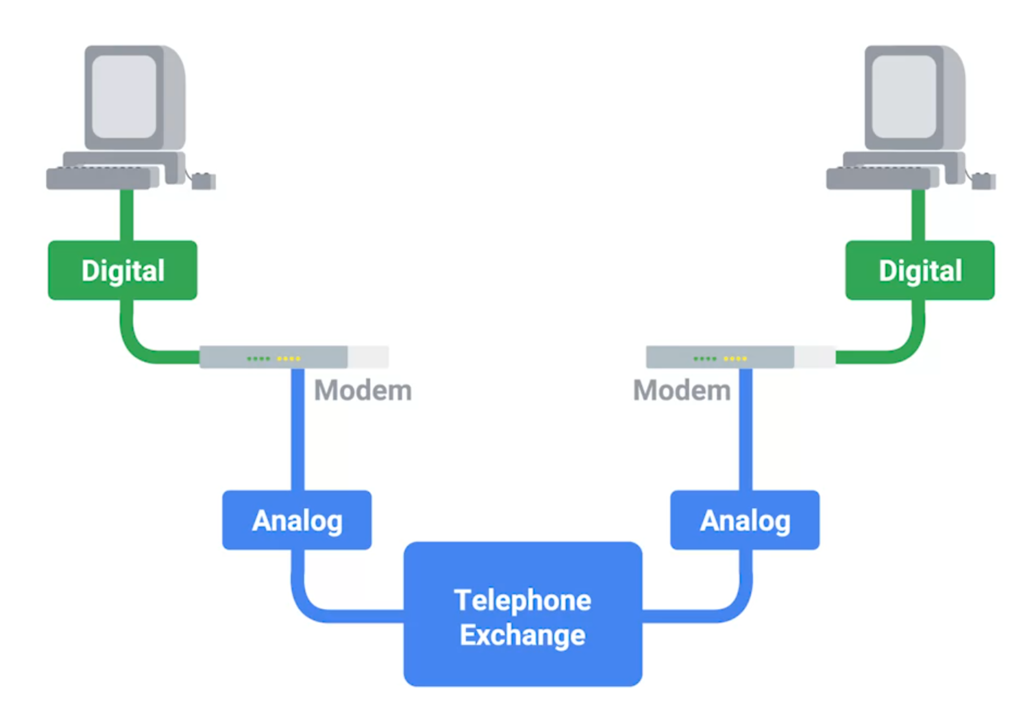
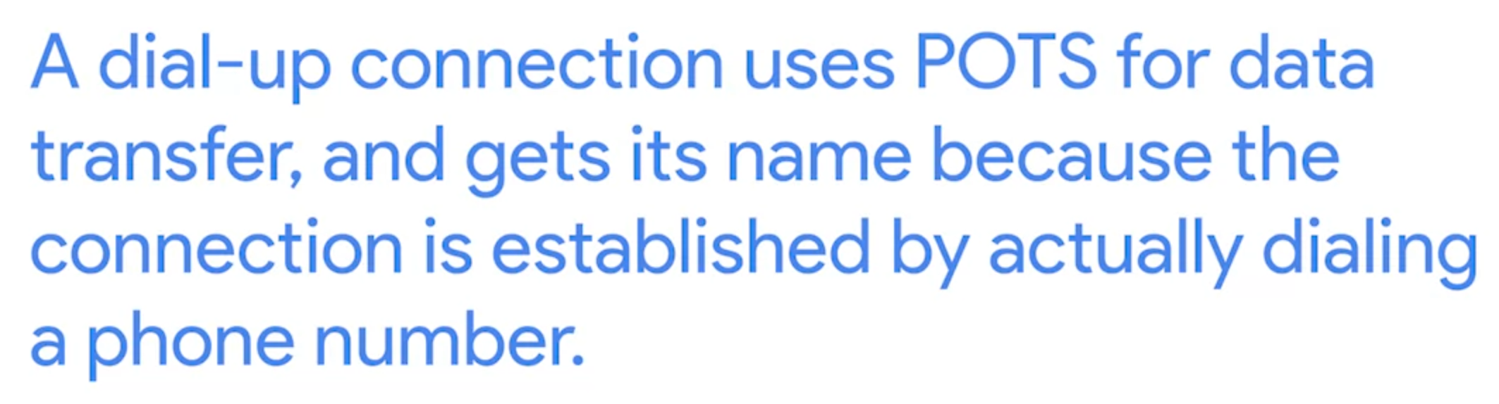
Dial-up, Modems and Point-to-Point Protocols

Slide 2
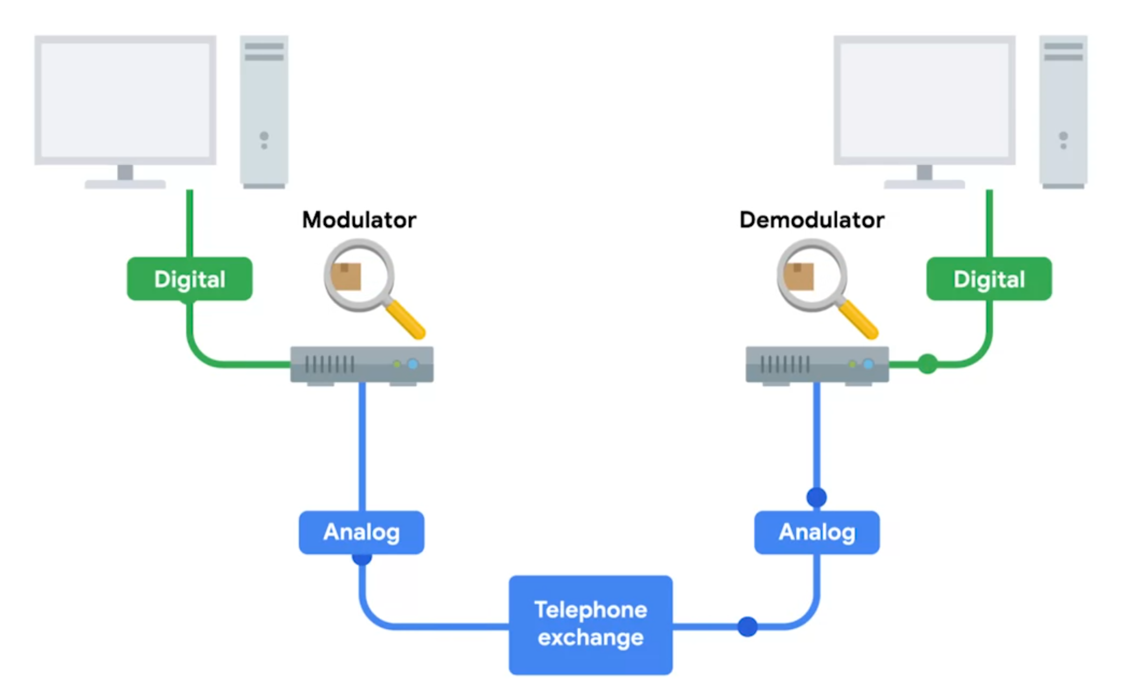
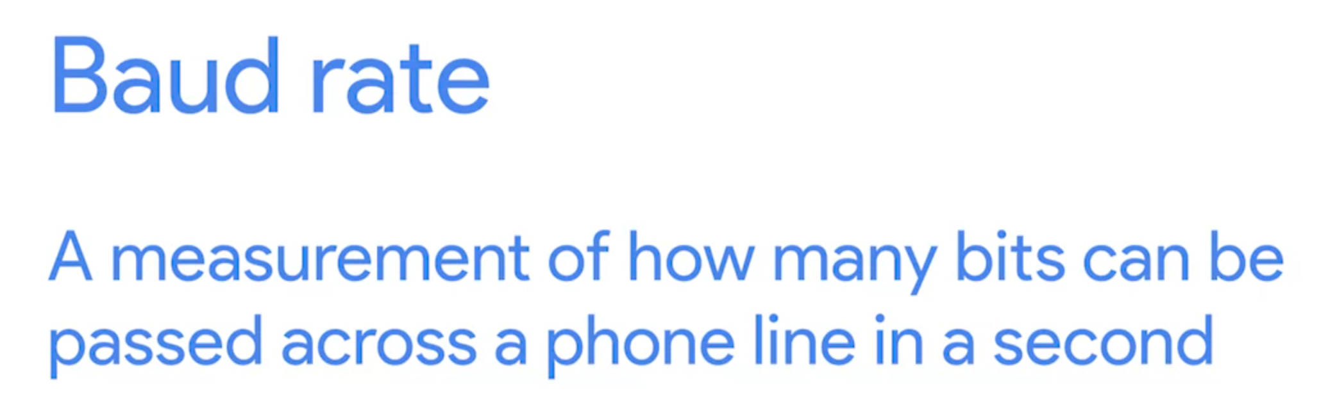
Public Switched telephone network (PSTN) | Plain Old Telephone Service (POTS)

Slide 3
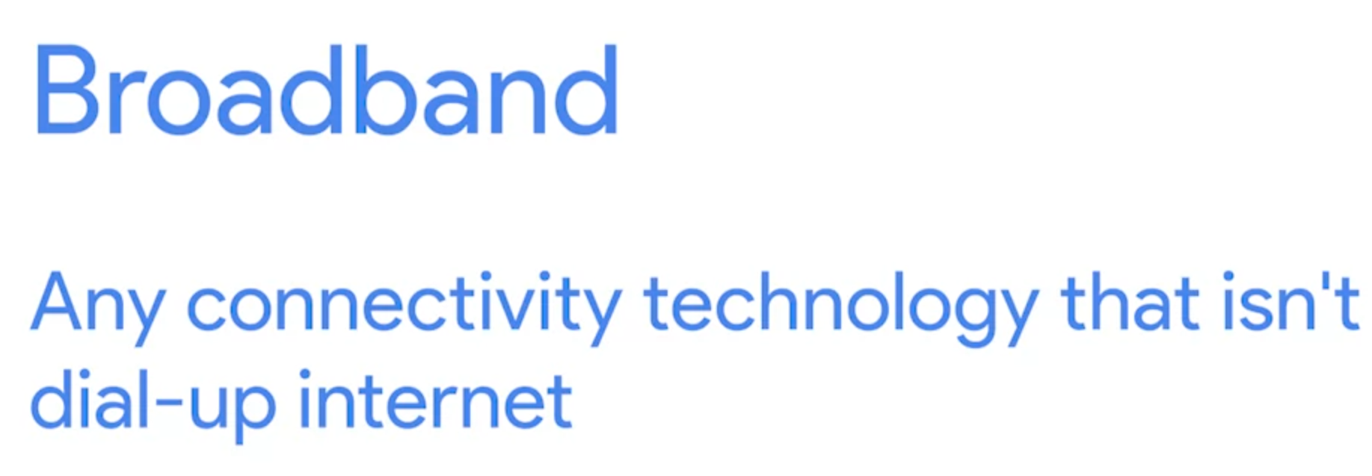
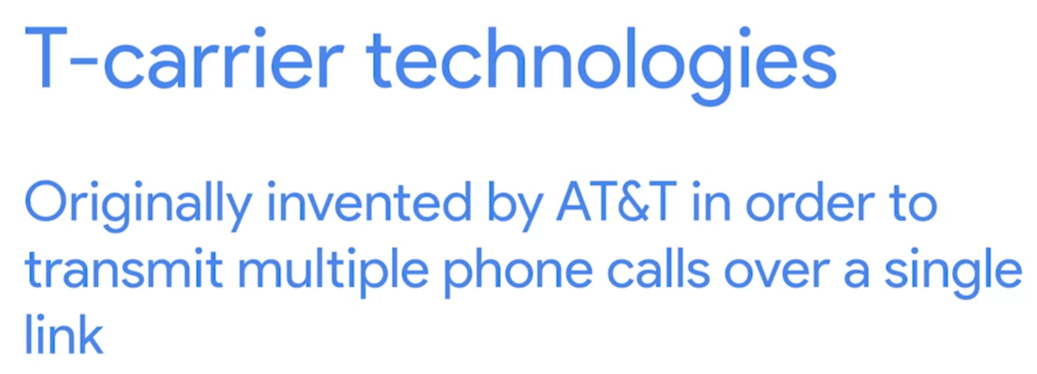
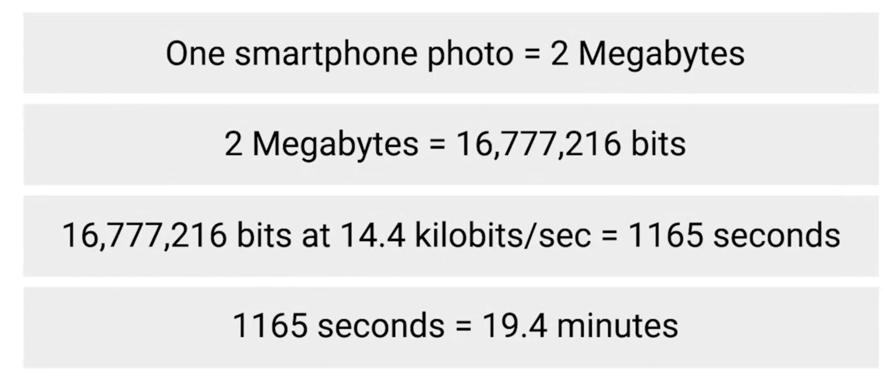
What is broadband?
One of the most common broadband technology (business )
If we use POTS to download a single image:

Slide 4
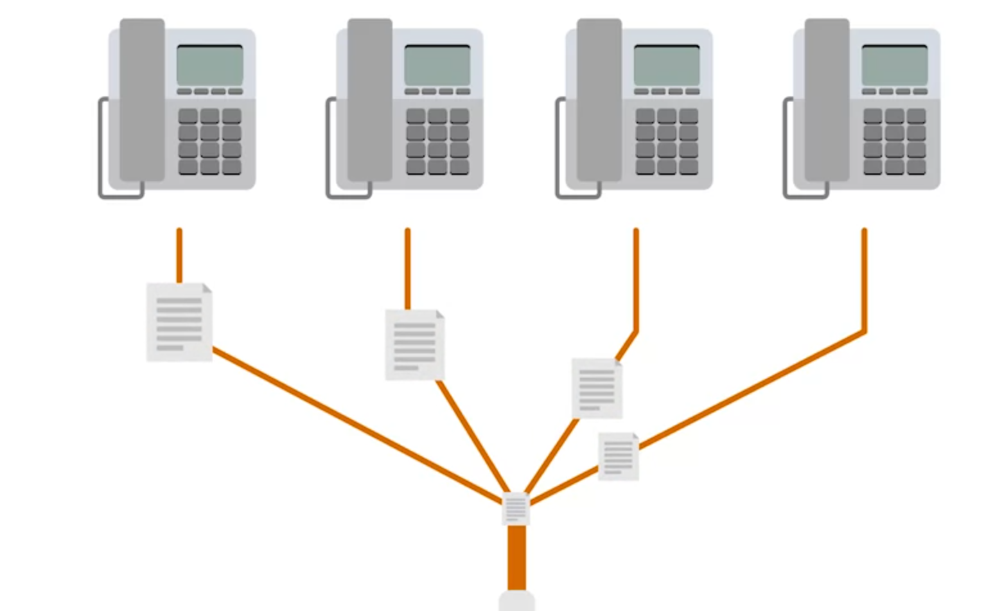
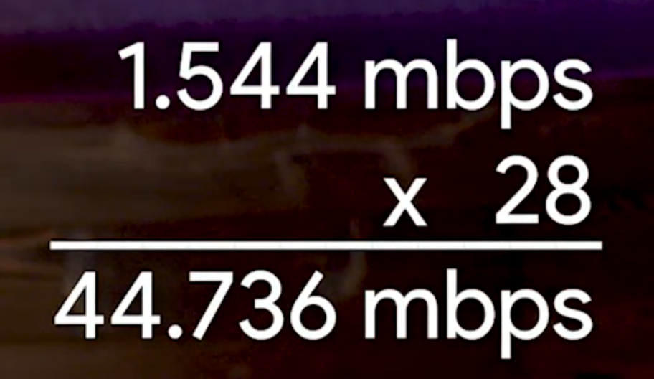
T-Carrier Technologies (dial-up connections)
T1 line(Transmission System 1) is a twisted copper cable, each one could transfer data individually
Speed of T3 cable (made by 28 T1 lines)

Slide 5
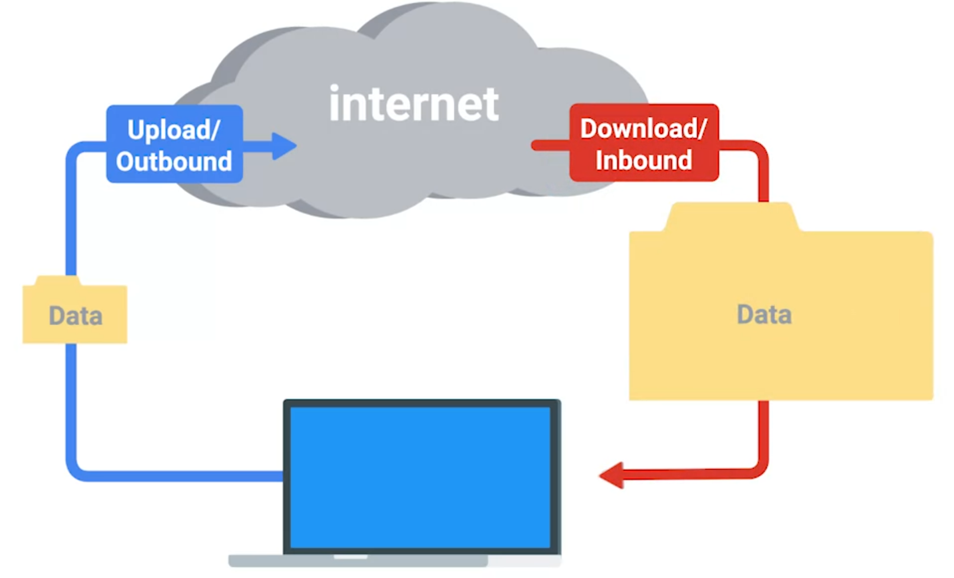
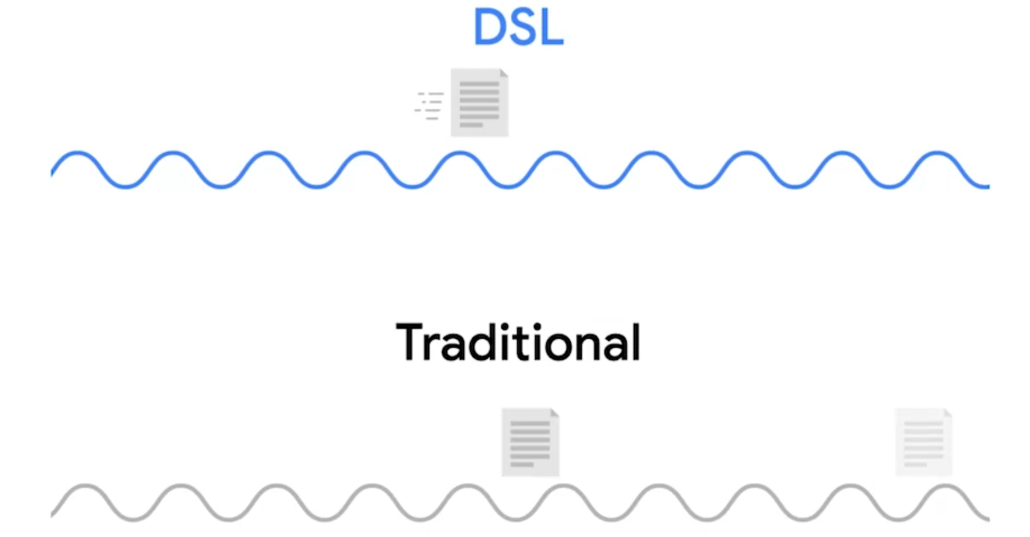
Digital Subscriber Lines
Asymmetric digital subscriber line (ADSL) have higher download speed but lower upload speed (for home user)
Use the copper cable (just like T-carrier) but different frequency to speed up the transfer rate. It allow phone call and data transfer to occur at the same time

Slide 6
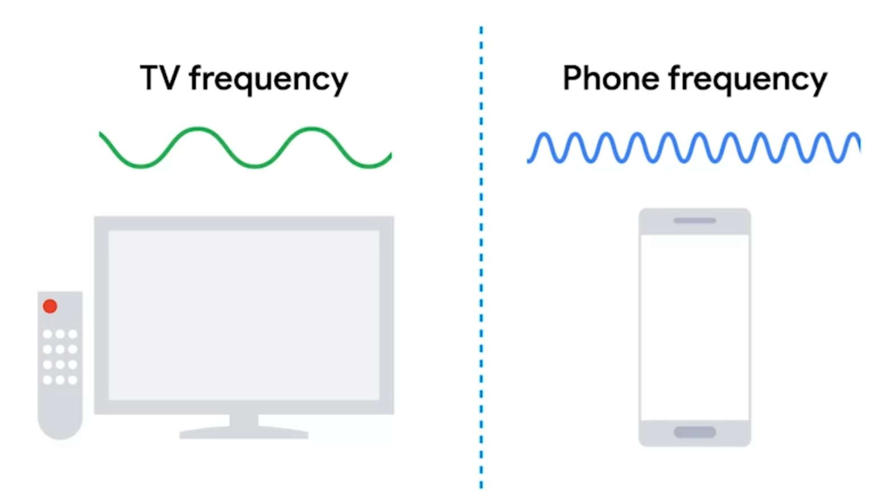
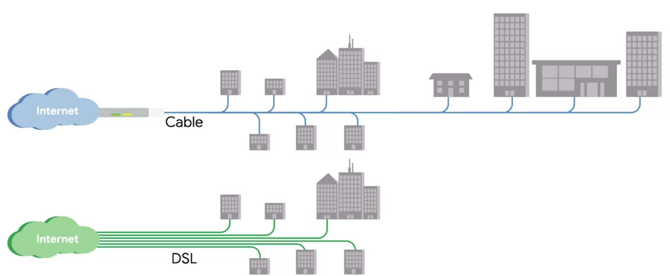
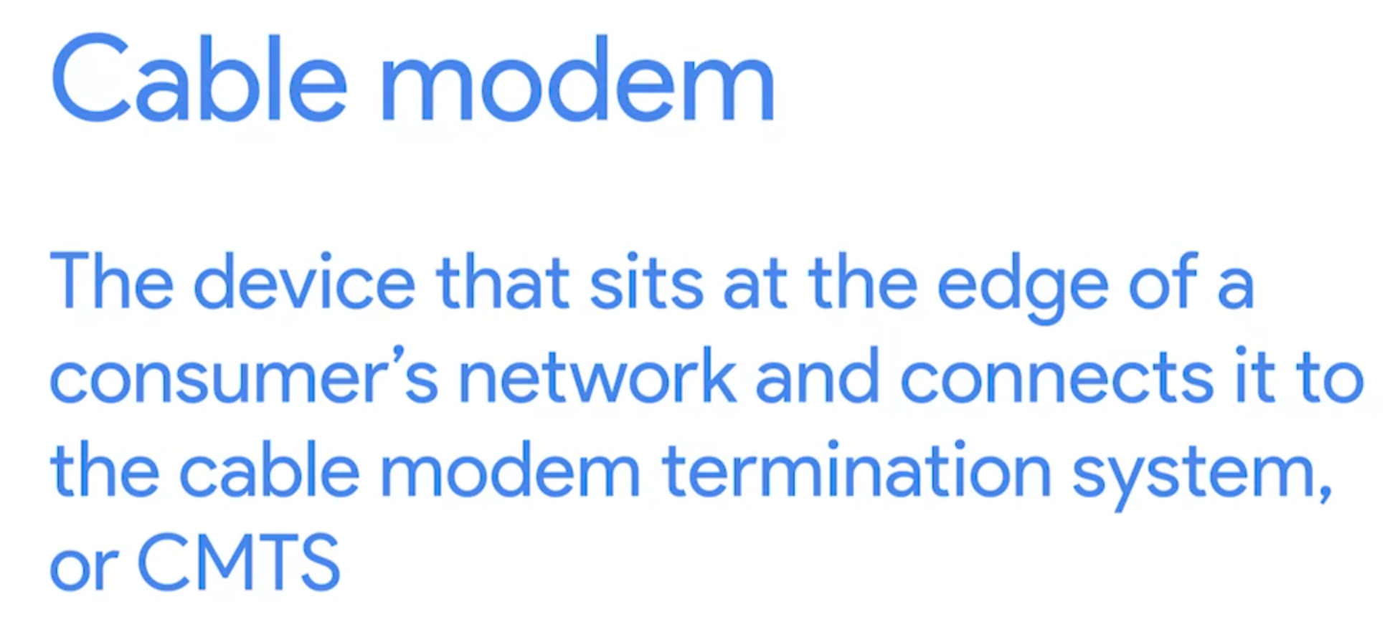
Cable Broadband (shared bandwidth technology)
Use the same cable but different frequency to host both TV and internet. It’s managed by cable modem

Slide 7


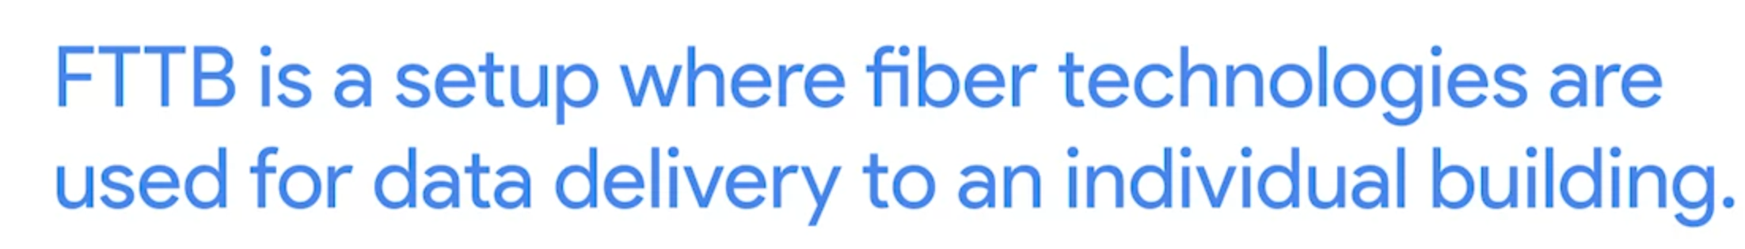
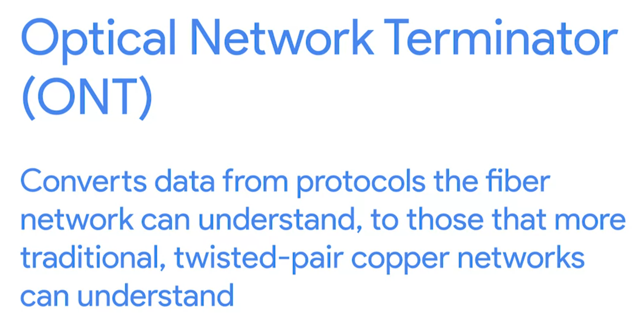

Fiber Connections
Use light instead of electrical current to transfer data
FTTX fiber to the X. X have a lot of possibility
FTTN (Fiber to the Neighborhood)
FTTB (Fiber to the building)
FTTH (Fiber to the Home)

Slide 8
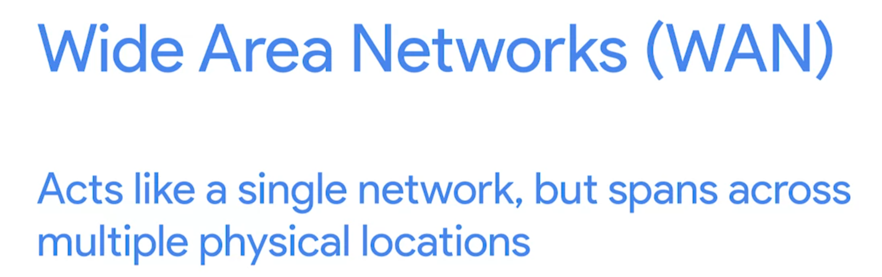
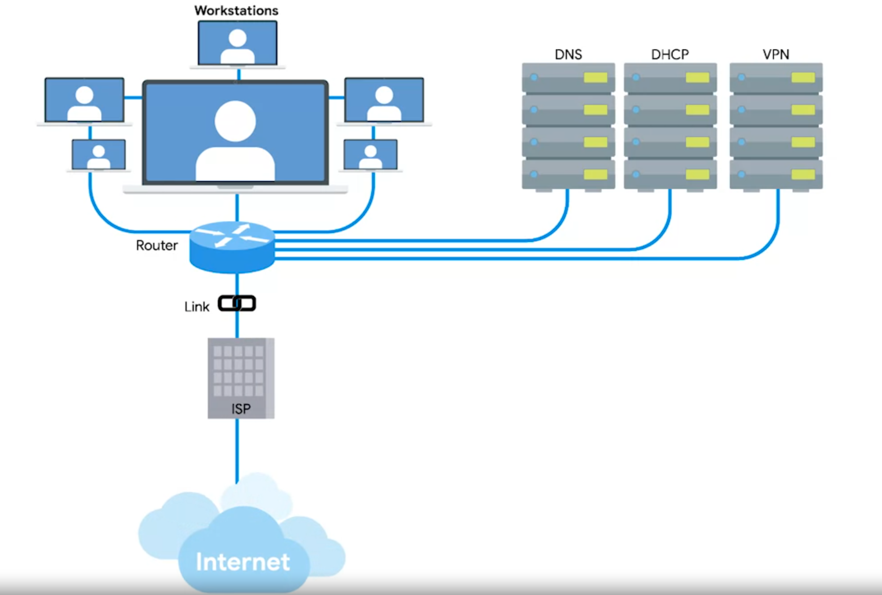
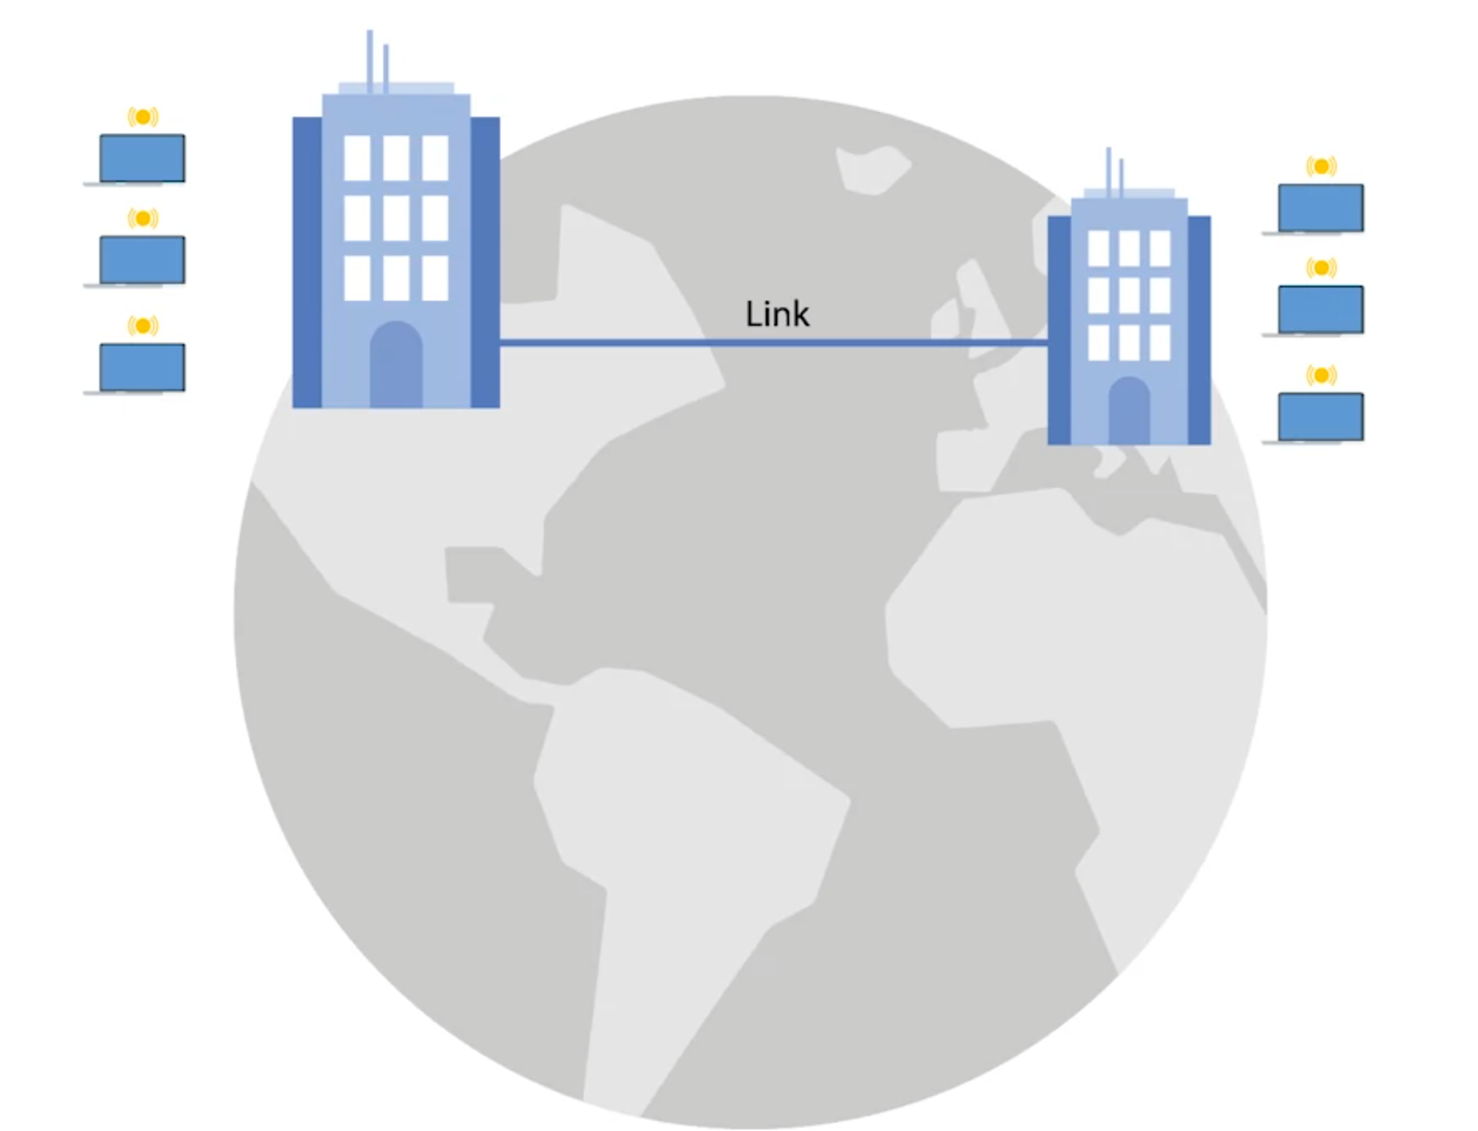
Wide Area Network Technologies (WAN)
WAN use some protocol that works at the data-link layer,
Like T-Carrier, Use ISP’S link to connect two networks together

Slide 9
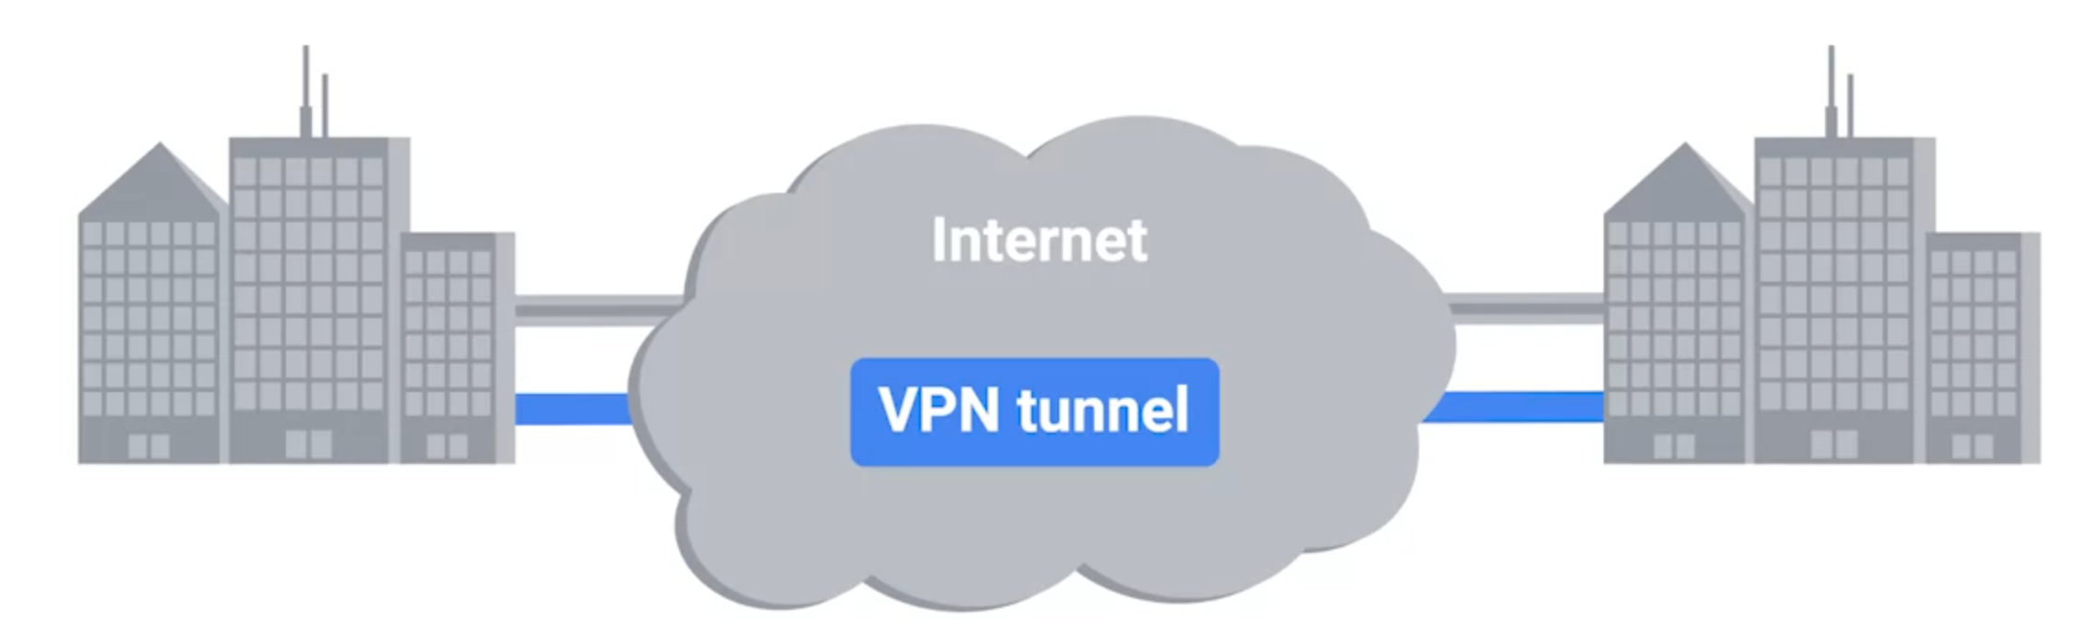
Point-to-Point VPNs (Site to Site VPN)

Slide 10
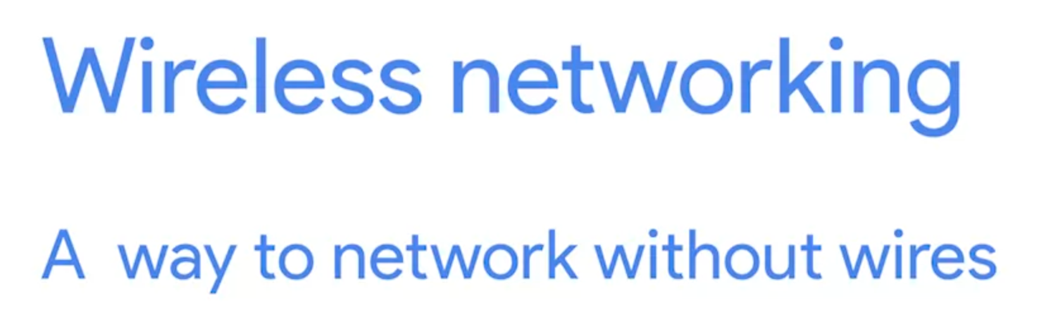

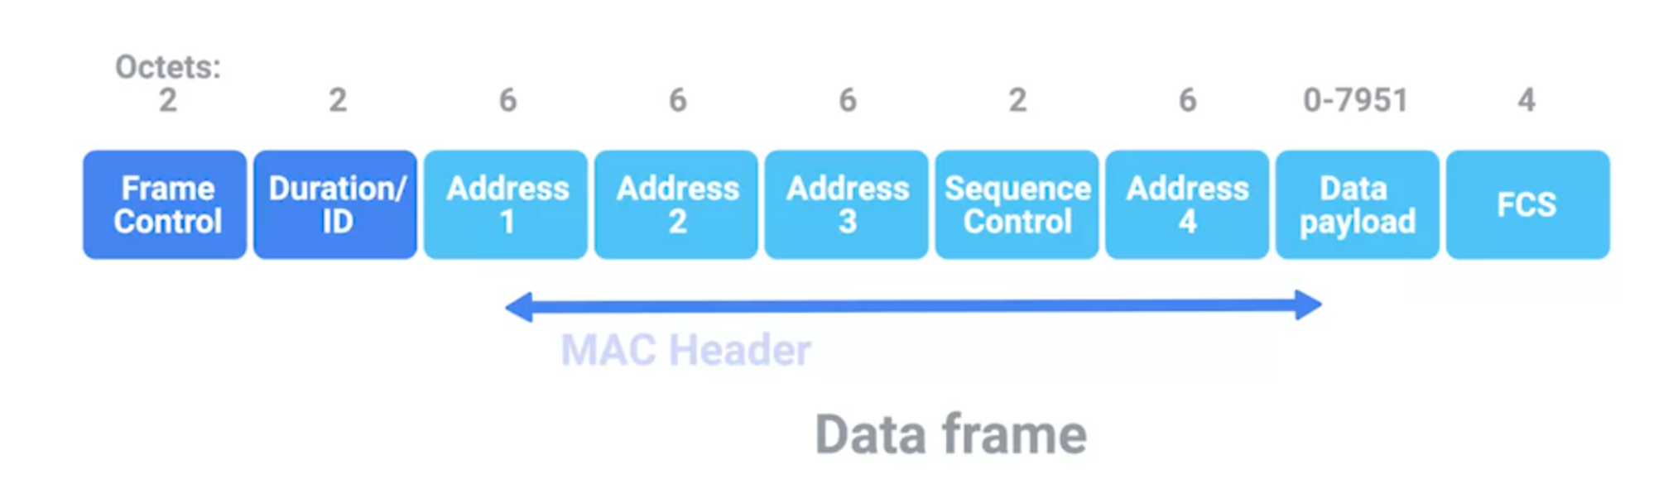
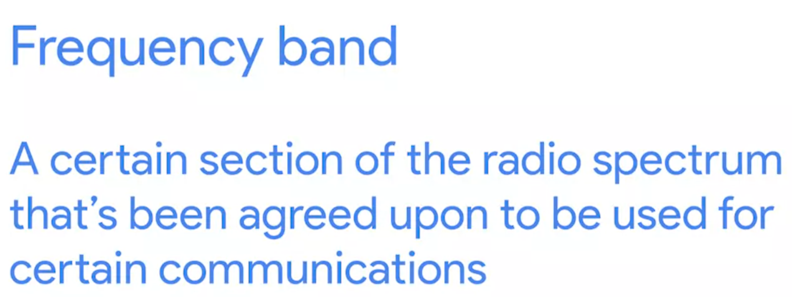

Wireless Networking Technologies
802 Protocol is used to Wireless networks.
It’s called FM broadcast frequency. For WIFI, usually we use 2.4Ghz and 5Ghz

Slide 11
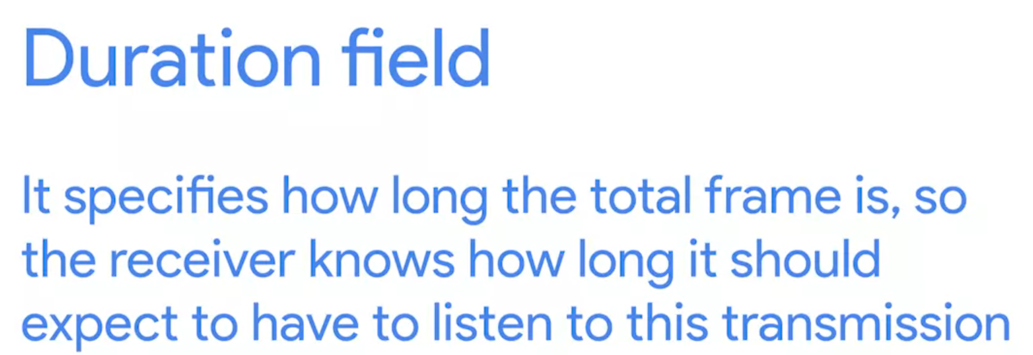
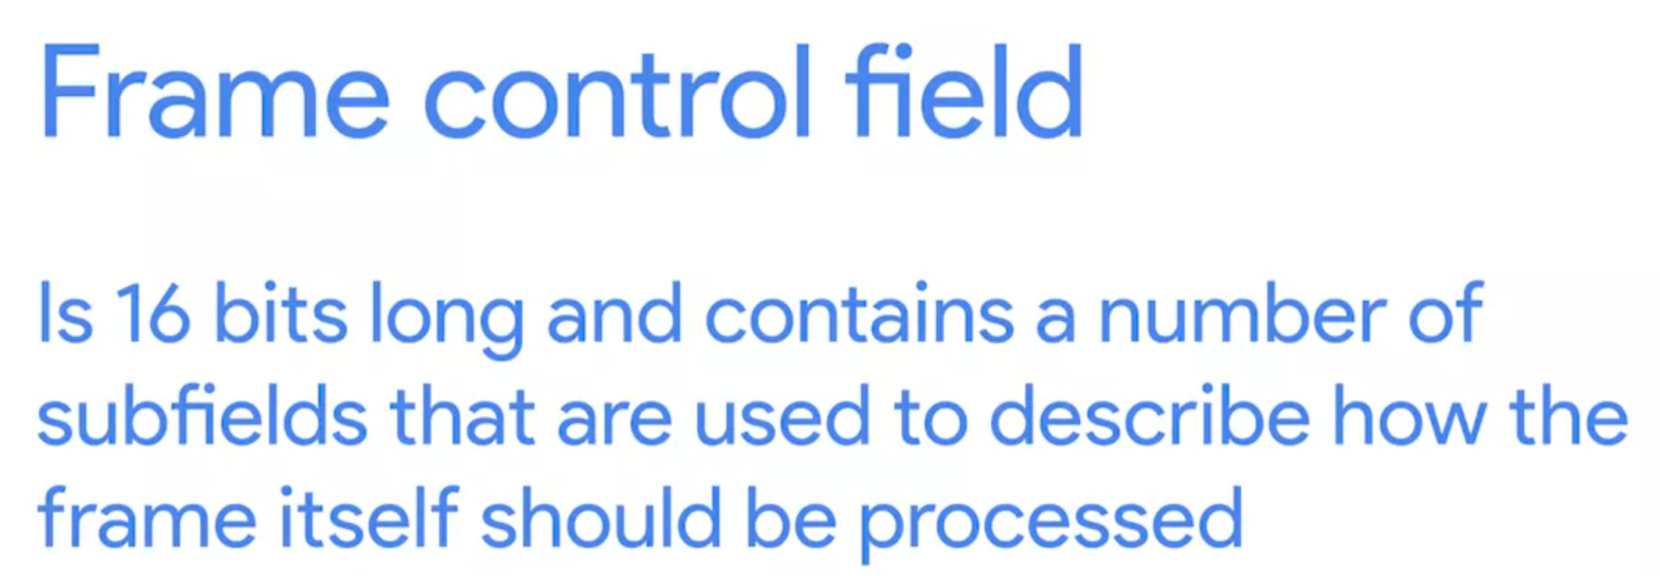

Slide 12
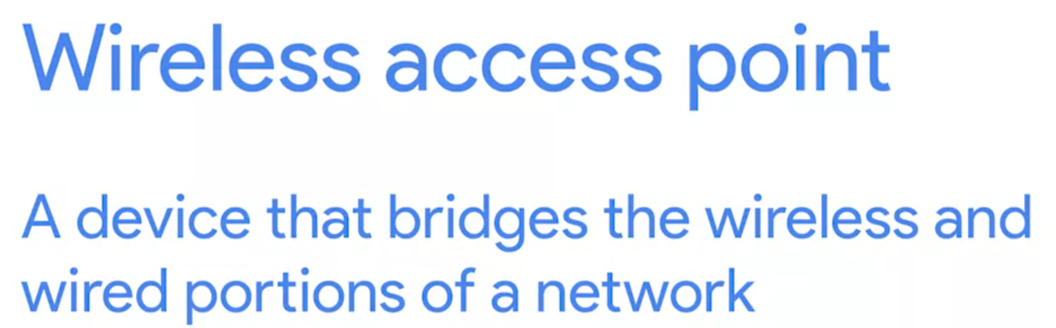
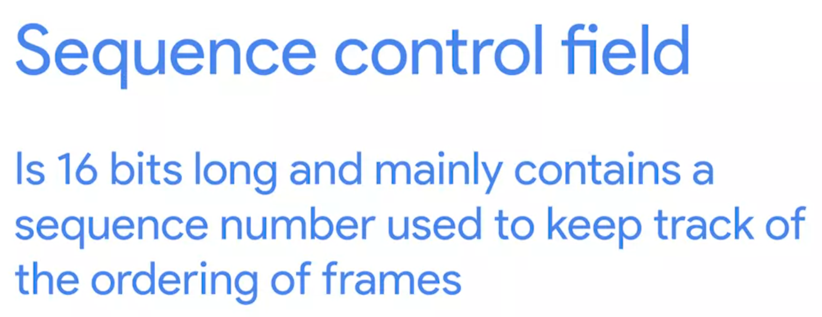
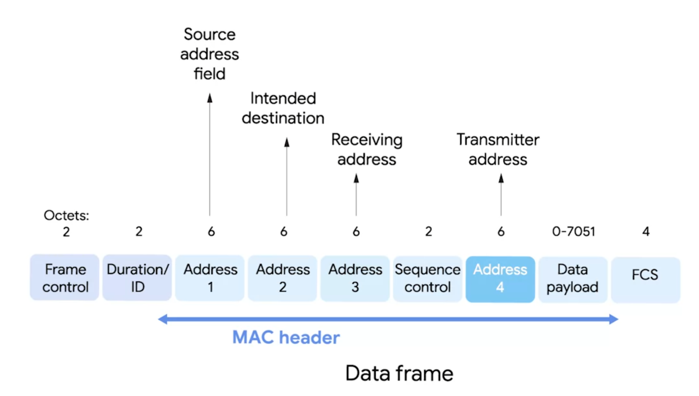
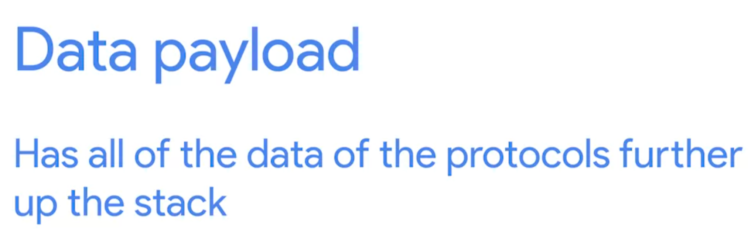
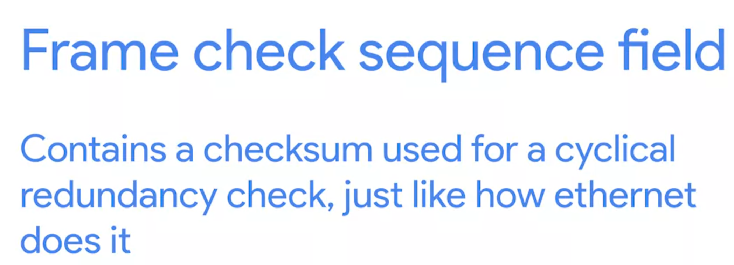
Receiving address is the MAC address of the access point that should receive the frame
Transmitter address is the MAC address of the transmitter (Not the destination)

Slide 13

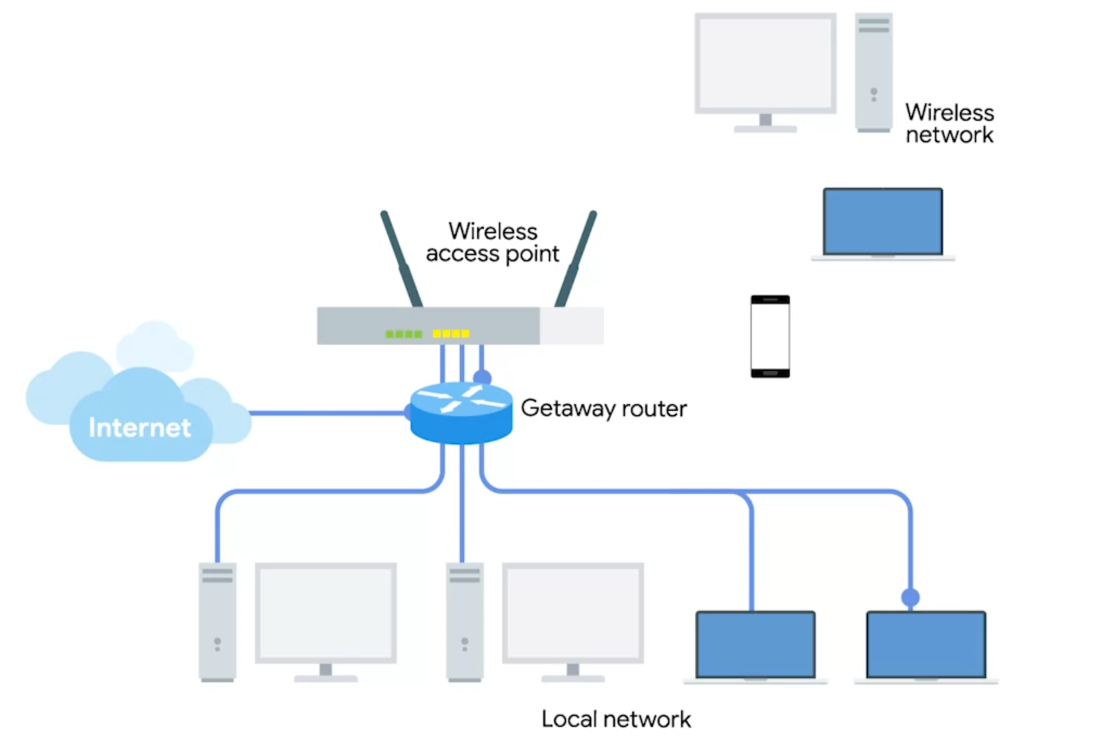
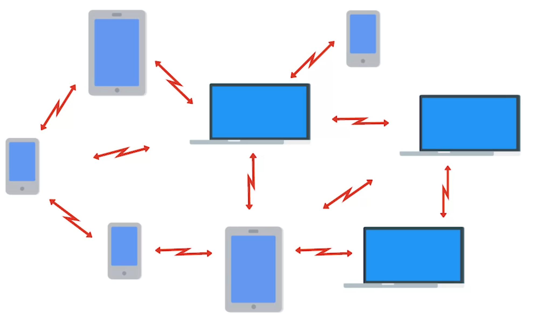
Wireless Network Configurations
Ad-hoc networks : all nodes speak directly to each other (effective under a disaster setting)
Wireless LANS (WLANS): one of more access points act as a bridge between a wireless and wired network (Most common)
Mesh networks: hybrid
WLANS

Slide 14
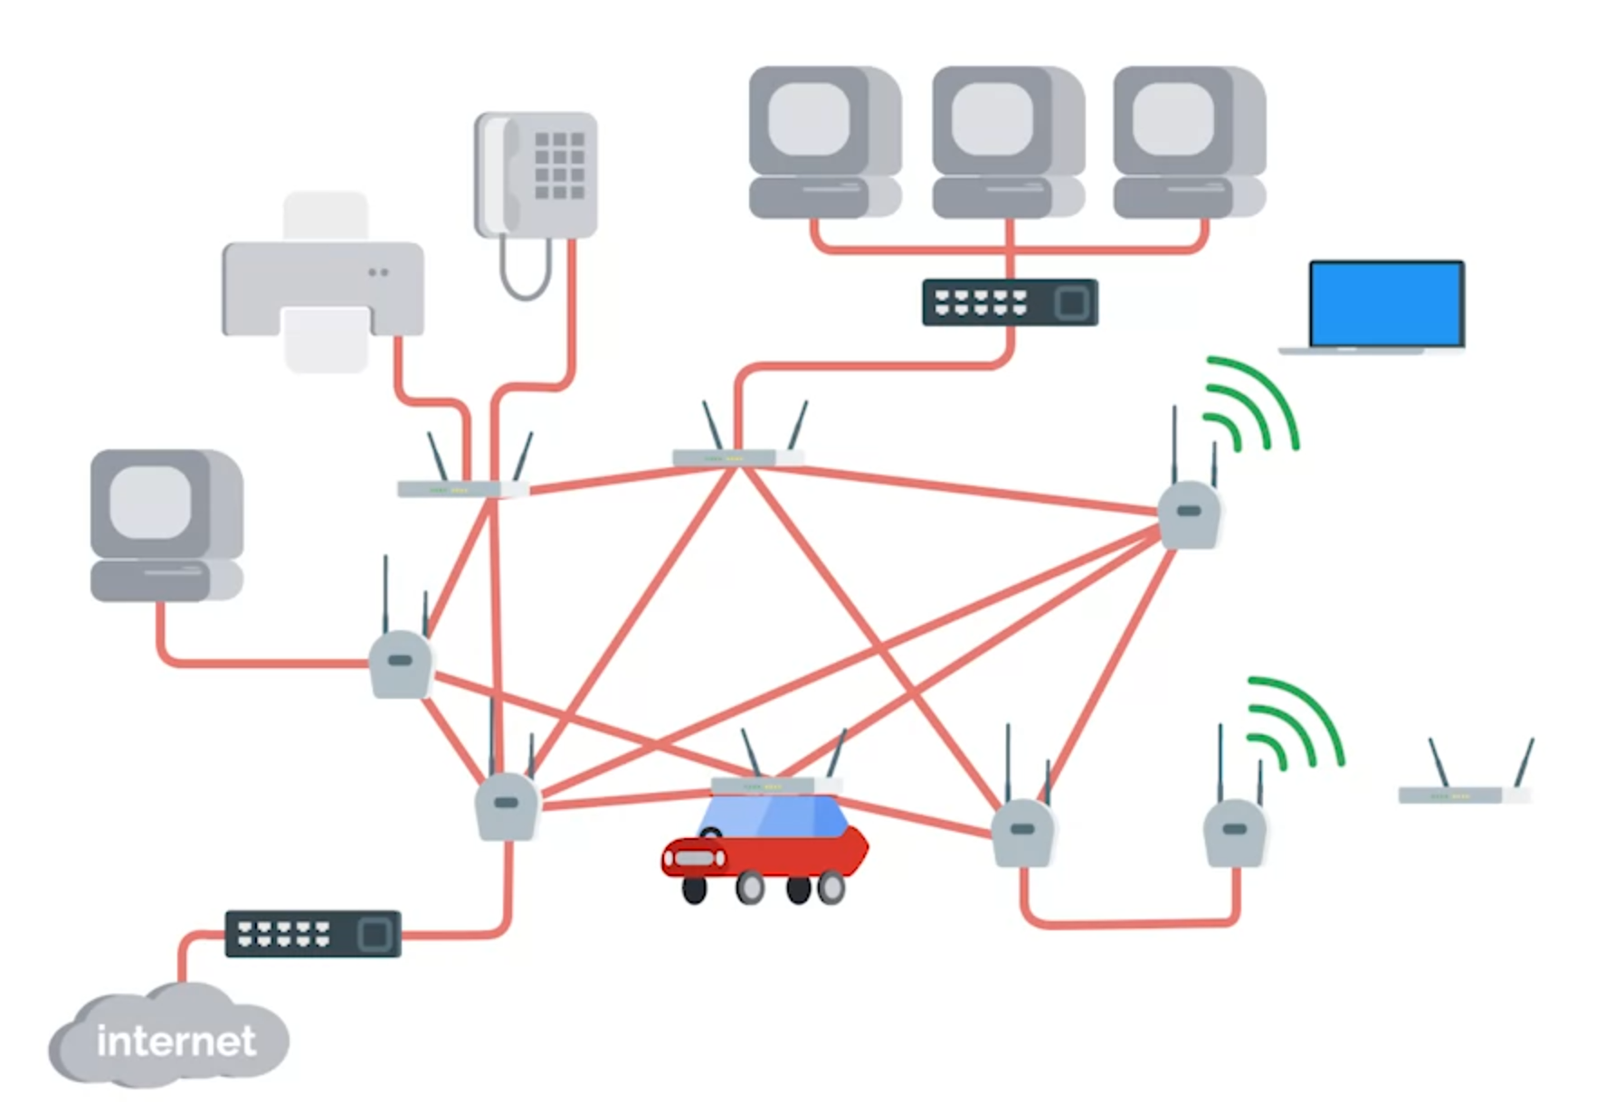
Mesh networks

Slide 15
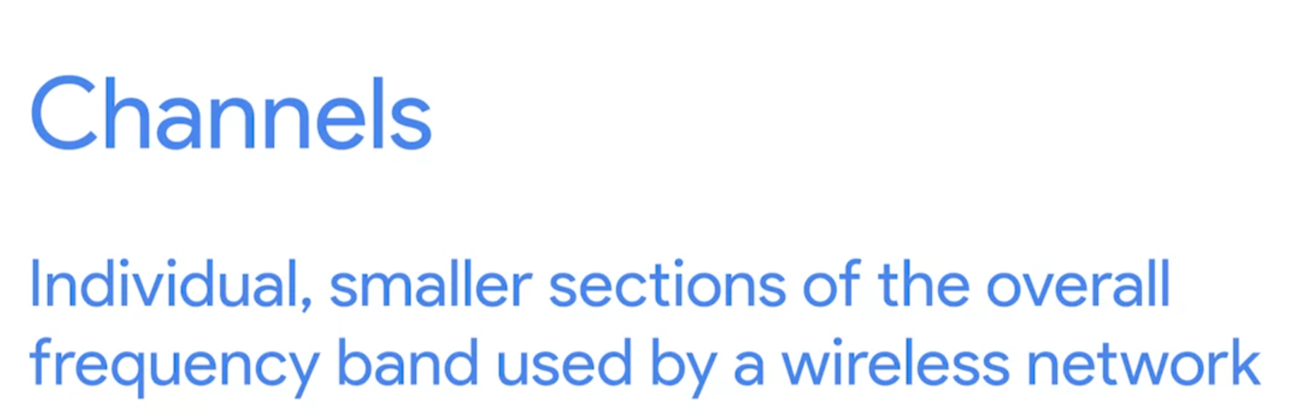
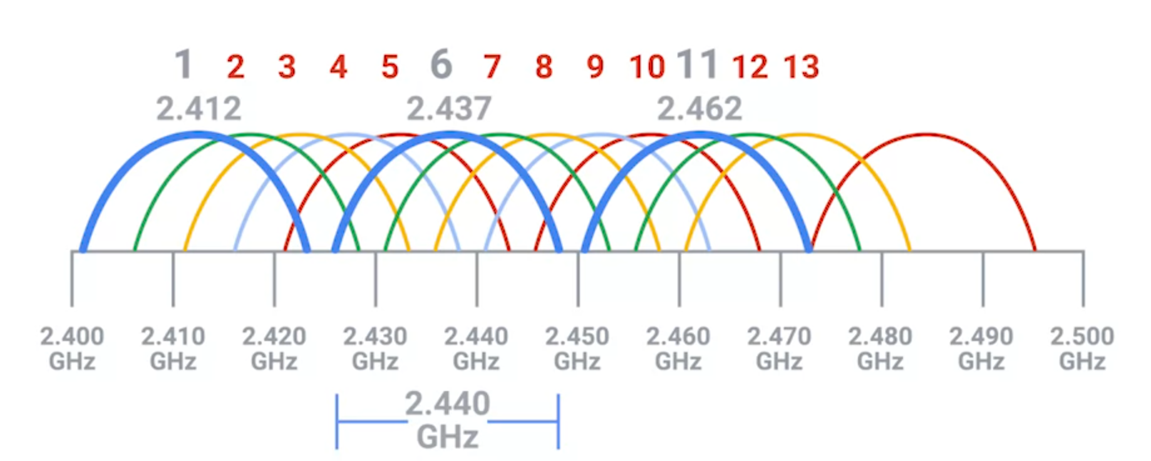
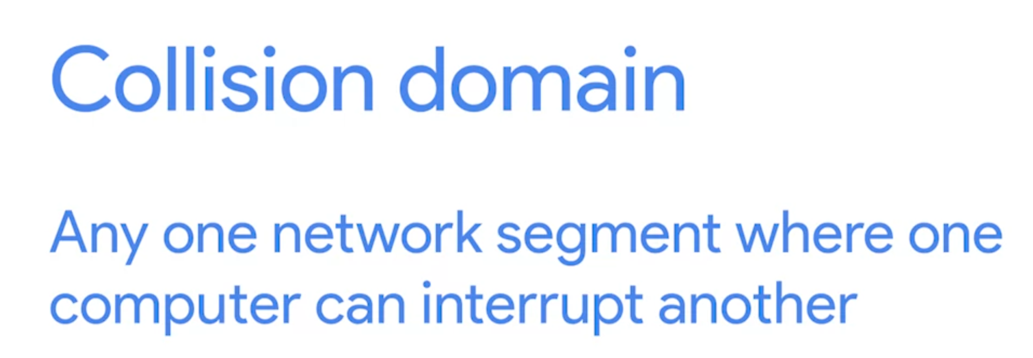

Wireless Channels
Channels for WLANS

Slide 16
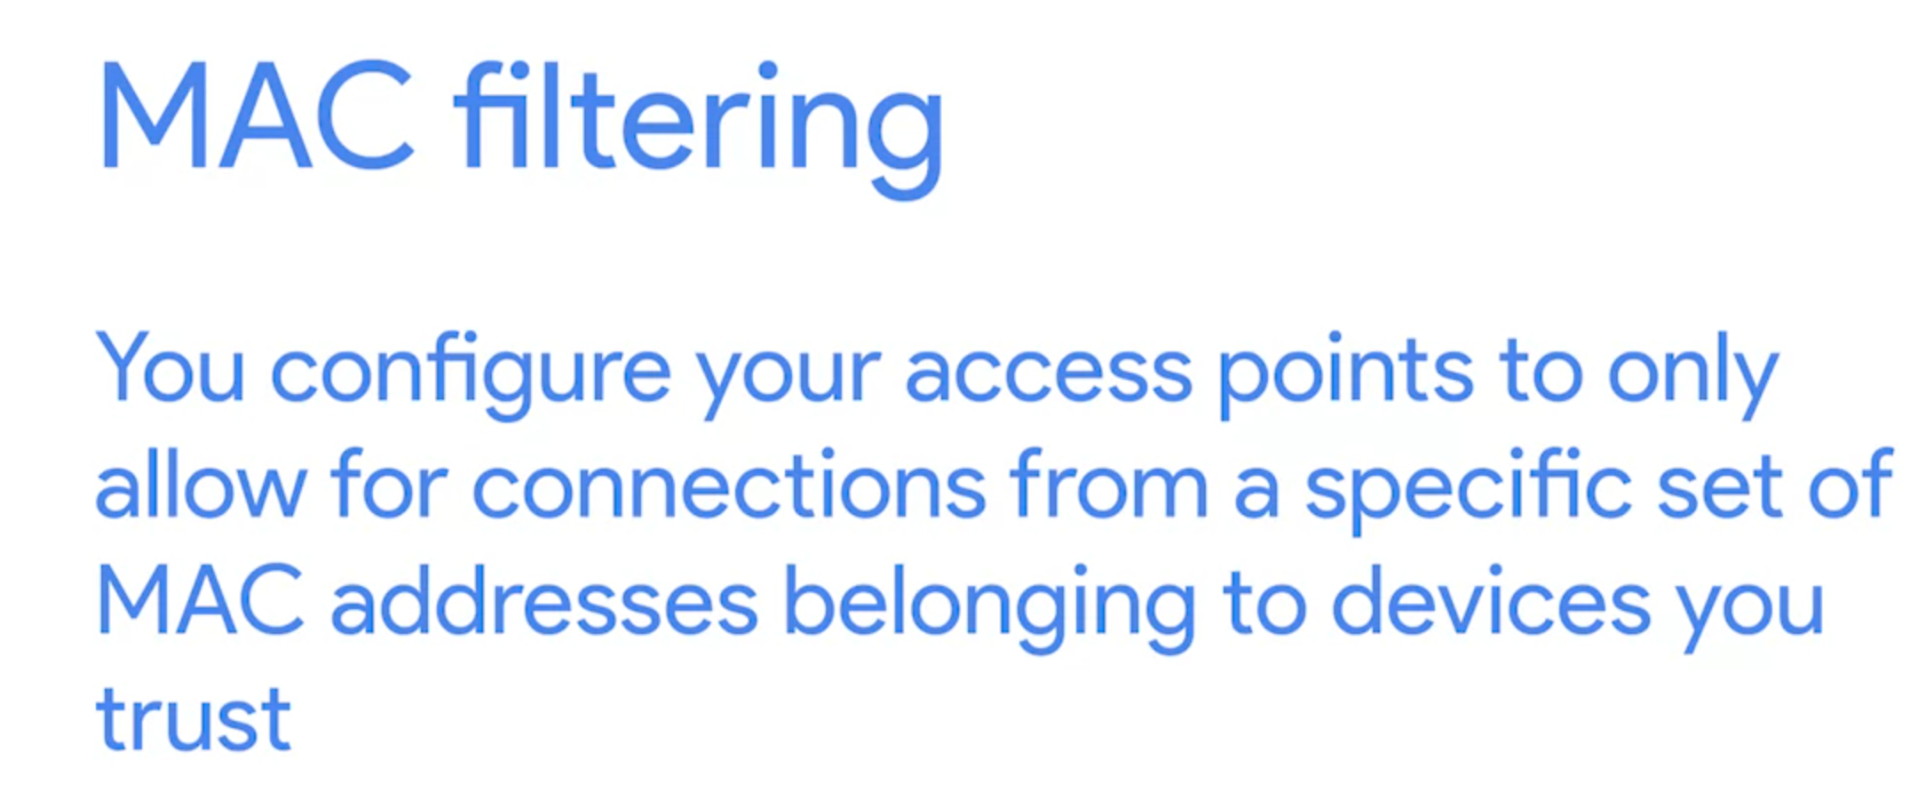
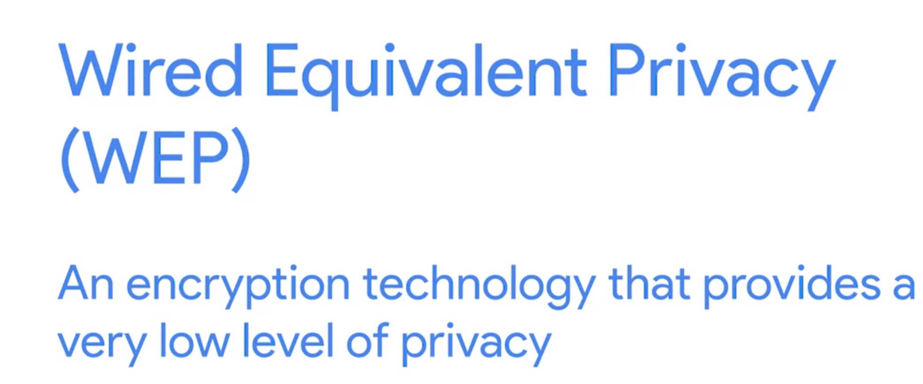
Wireless Security
More bits in a key, the longer it takes for someone to crack the encryption (safer)
WEP use 40 bits for encryption keys (cracked in few minutes)
So it is been replaced by WPA (WIFI Protected Access)
WPA use 128 bits keys
WPA2 use 256 bits keys

Slide 17
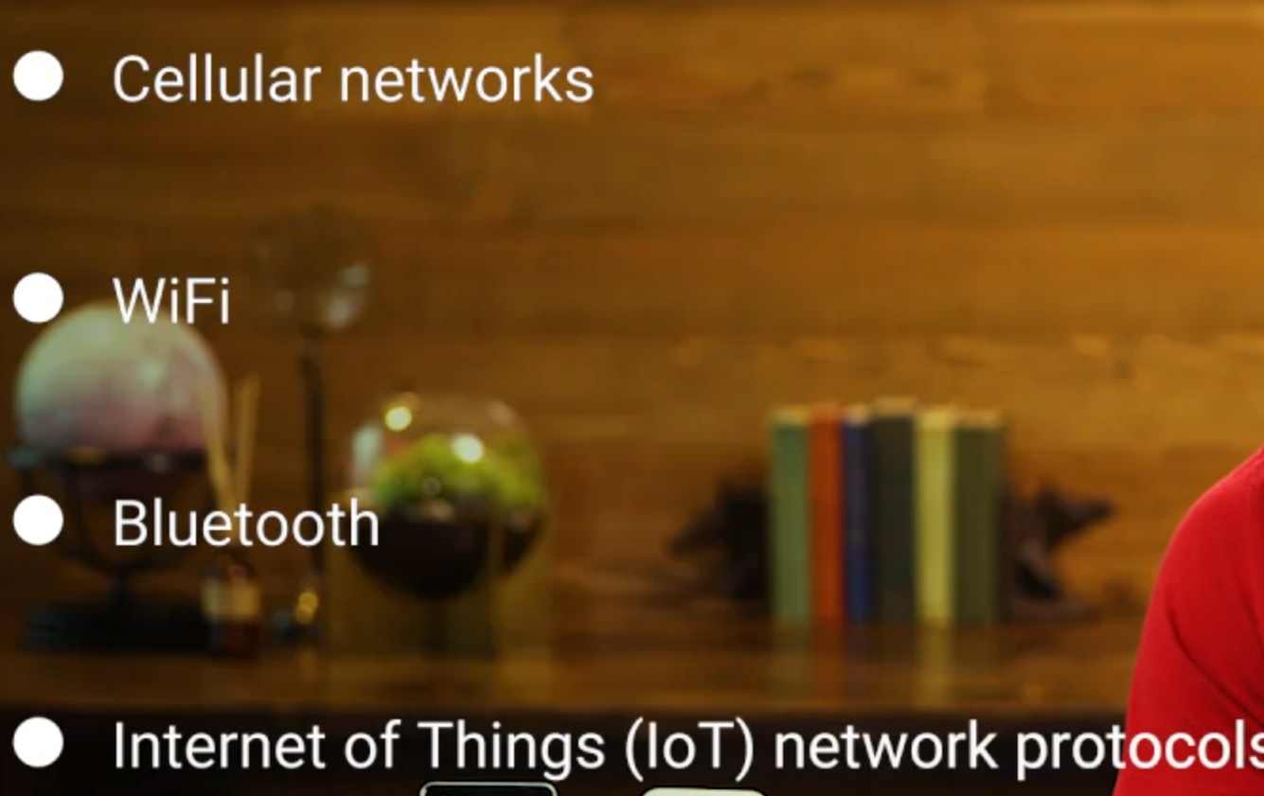
Cellular Networking (Mobile Networking)

